Slide 1
Foundations of Cryptography Kasiski’s method, index of coincidence method, principles of modern cryptography, security guarantee, threat model, finite probability
LiangFeng Zhang
zhanglf@shanghaitech.edu.cn
SIST, ShanghaiTech, 2019F

Slide 2
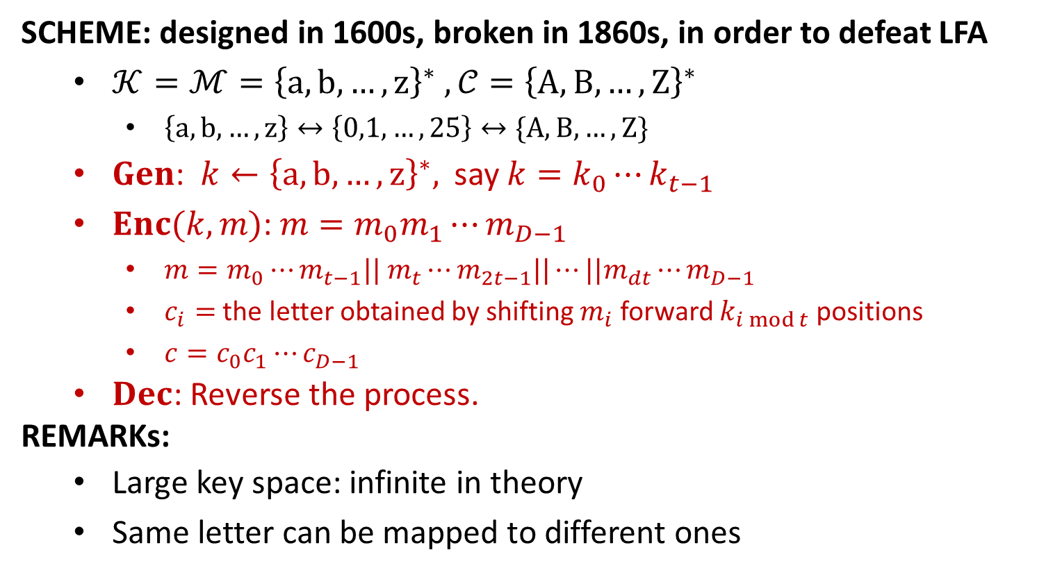
Vigenère Cipher
SCHEME: designed in 1600s, broken in 1860s, in order to defeat LFA
$𝒦=ℳ={\left\{a, b,…, z\right\}}^{∗} , 𝒞={\left\{A,B,…,Z\right\}}^{∗}$
$\left\{a, b,…, z\right\}↔\left\{0,1,…,25\right\}↔\{A,B,…,Z\}$
$Gen$: $k←{\left\{a,b,…,z\right\}}^{∗},$ say $k=k_{0}⋯k_{t−1}$
$Enc(k,m)$: $m=m_{0}m_{1}⋯m_{D−1}$
$m=m_{0}⋯m_{t−1}|| m_{t}⋯m_{2t−1}||⋯||m_{dt}⋯m_{D−1}$
$c_{i}=$ the letter obtained by shifting $m_{i}$ forward $k_{i mod t}$ positions
$c=c_{0}c_{1}⋯c_{D−1}$
$Dec$: Reverse the process.
REMARKs:
Large key space: infinite in theory
Same letter can be mapped to different ones

Slide 3



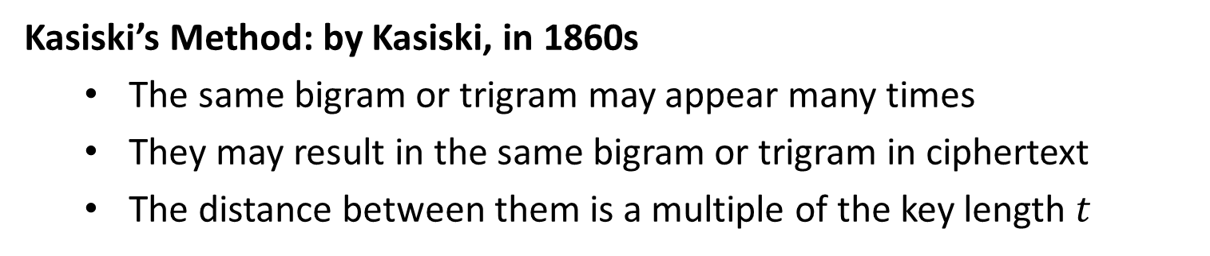
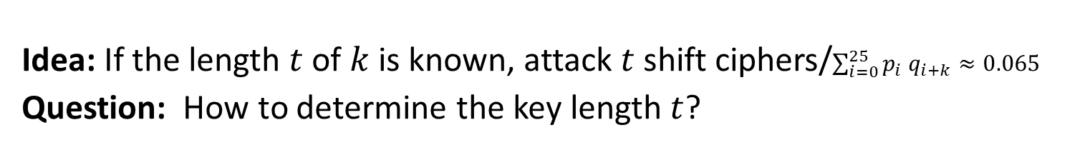
Attacks
Idea: If the length $t$ of $k$ is known, attack $t$ shift ciphers/$\sum_{i=0}^{25}{p_{i} q_{i+k}≈0.065}$
Question: How to determine the key length $t$?
$$↑$$
$$↑$$
Kasiski’s Method: by Kasiski, in 1860s
The same bigram or trigram may appear many times
They may result in the same bigram or trigram in ciphertext
The distance between them is a multiple of the key length $t$
$t|30:t∈\{1,2,3,5,6,10,15,30\}$

Slide 4
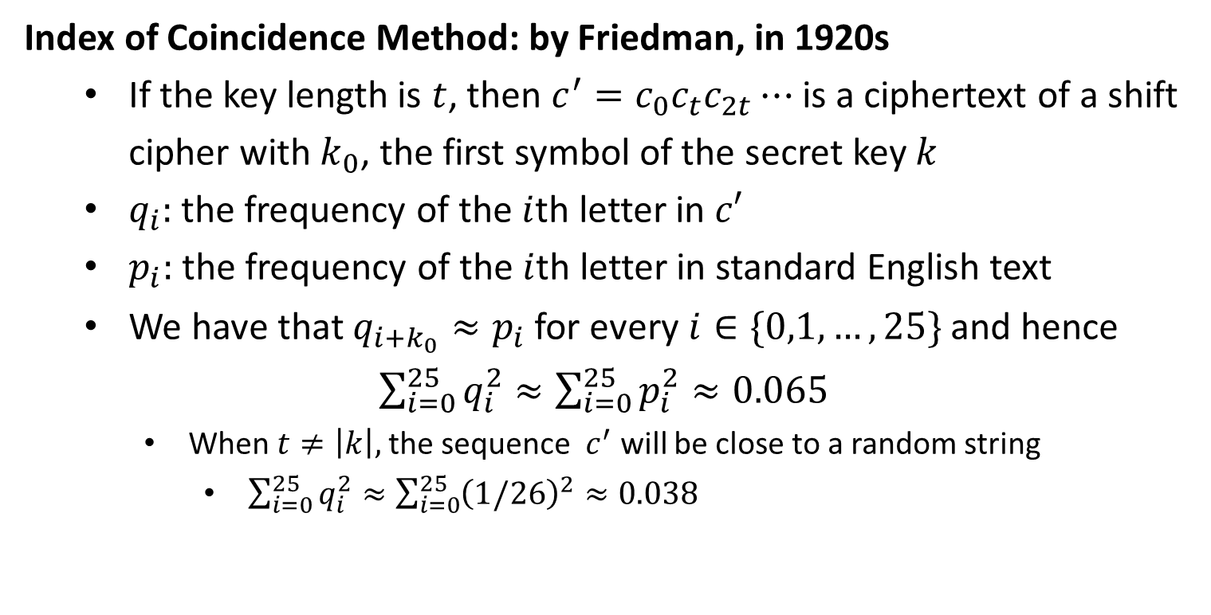
Attacks
Index of Coincidence Method: by Friedman, in 1920s
If the key length is $t$, then $c^{′}=c_{0}c_{t}c_{2t}⋯$ is a ciphertext of a shift cipher with $k_{0}$, the first symbol of the secret key $k$
$q_{i}:$ the frequency of the $i$th letter in $c′$
$p_{i}:$ the frequency of the $i$th letter in standard English text
We have that $q_{i+k_{0}}≈p_{i}$ for every $i∈\{0,1,…,25\}$ and hence
$\sum_{i=0}^{25}{q_{i}^{2}}≈\sum_{i=0}^{25}{p_{i}^{2}≈0.065}$
When $t≠\left|k\right|,$the sequence ${ c}^{′}$ will be close to a random string
$\sum_{i=0}^{25}{q_{i}^{2}}≈\sum_{i=0}^{25}{{\left(1/26\right)}^{2}}≈0.038$

Slide 5
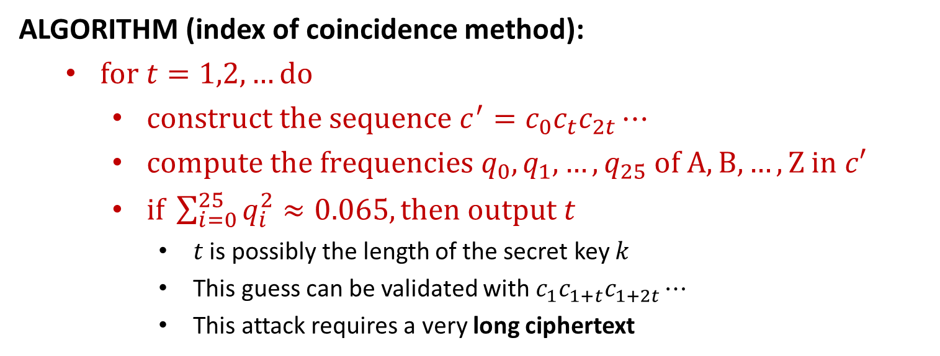
Attacks
ALGORITHM (index of coincidence method):
$for t=1,2,…do$
$construct the sequence c^{′}=c_{0}c_{t}c_{2t}⋯$
$compute the frequencies q_{0},q_{1},…,q_{25}$ $of A, B,…,Z$ $in$ $c′$
$if \sum_{i=0}^{25}{q_{i}^{2}}≈0.065, then output t$
$t$ is possibly the length of the secret key $k$
This guess can be validated with $c_{1}c_{1+t}c_{1+2t}⋯$
This attack requires a very long ciphertext

Slide 7
Classical & Modern Cryptography
All historical ciphers have been BADLY broken
The adversary learns only one ciphertext
The adversary can recover both the message and the secret key
Lessons of Classical Cryptography: it is like an art, not a science
Don’t tell us how secure a given system is
Don’t prove that a given system is secure
Principles of Modern Cryptography (a science)
Formal Definitions of Security
Precise Assumptions
Proofs of Security

Slide 8
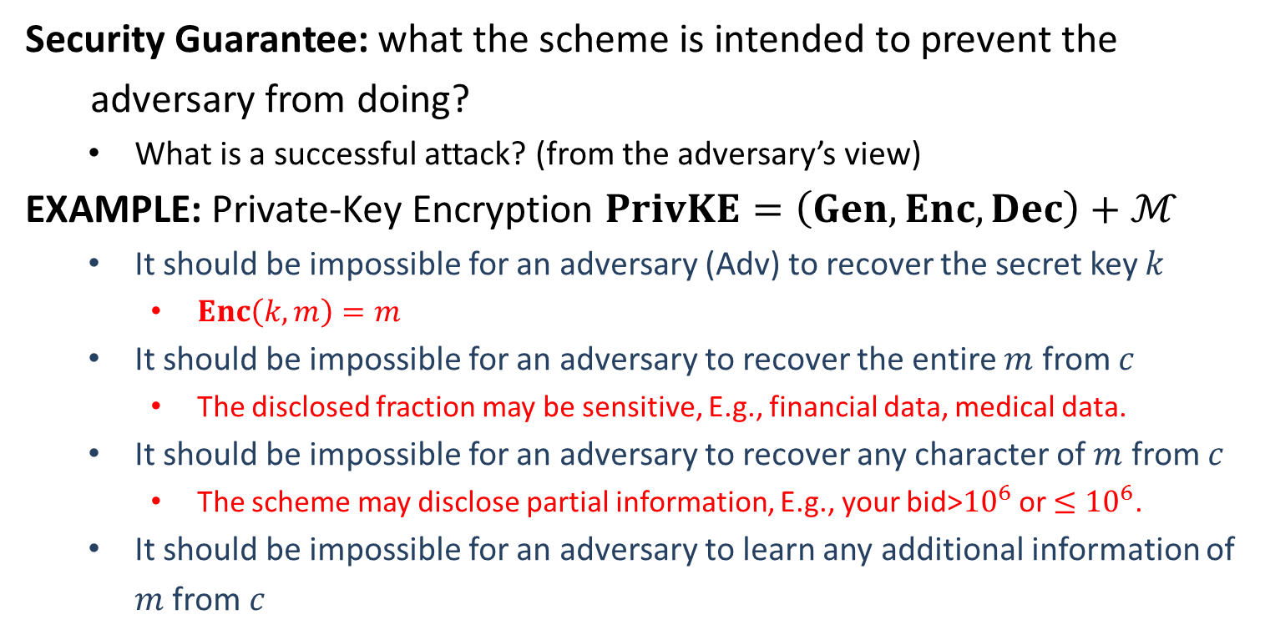
Formal Definitions of Security
Security Guarantee: what the scheme is intended to prevent the
adversary from doing?
What is a successful attack? (from the adversary’s view)
EXAMPLE: Private-Key Encryption $PrivKE=\left(Gen, Enc, Dec\right)+ℳ$
It should be impossible for an adversary (Adv) to recover the secret key $k$
$Enc\left(k,m\right)=m$
It should be impossible for an adversary to recover the entire $m$ from $c$
The disclosed fraction may be sensitive, E.g., financial data, medical data.
It should be impossible for an adversary to recover any character of $m$ from $c$
The scheme may disclose partial information, E.g., your bid>${10}^{6}$ or $≤{10}^{6}$.
It should be impossible for an adversary to learn any additional information of $m$ from $c$
Insecure! The entire plaintext is disclosed to the adversary.
This is a good security guarantee.

Slide 9
Formal Definitions of Security
Threat Model: defines the power of the adversary
What actions the adversary is assumed able to carry out?
Ciphertext-Only Attack (COA): The adversary observes a ciphertext (or multiple ciphertexts) . It tries to determine information about the underlying plaintext (or plaintexts).
Shift cipher, substitution cipher and Vigenère Cipher are all broken with COA.
Known-Plaintext Attack (KPA): The adversary learns one or more pairs of plaintext and ciphertext generated using some key. It tries to determine information about the underlying plaintext of some other ciphertext produced using the same key.
All historical ciphers are trivial to break with KPA.

Slide 10
Formal Definitions of Security
Chosen-Plaintext Attack (CPA): The adversary obtains plaintext/ciphertext pairs for plaintexts of its choice. It tries to determine information about the underlying plaintext of some other ciphertext produced using the same key.
Chosen-Ciphertext Attack (CCA): The adversary obtains plaintext/ciphertext pairs for plaintexts of its choice and ciphertext/plaintext pairs for ciphertexts of its choice. It tries to determine information about the underlying plaintext of some other ciphertext produced using the same key.
What is the computational power of the adversary?
A person with pencil and paper cannot break my system
The system may be easily broken with a desktop PC.
A person with desktop PC cannot break my system
The system may be easily broken with a supercomputer
A person with any supercomputer cannot break my system
The system looks good, at least for now.

Slide 11
Precise Assumptions
Assumption: Statements that are not proven but conjectured to be true
EXAMPLE: Integer factoring is hard
Modern cryptographic constructions are based on assumptions
Why Precise Assumptions:
Not precise, cannot be studied well, cannot establish confidence
Facilitate the comparison of schemes with different assumptions
Understanding the necessary assumptions

Slide 12
Proofs of Security
Provable Security: If the designed cryptographic scheme can be broken
by an adversary, then the underlying assumption is false.
Proof is relative to the security definition and the assumption
How to Claim Security? Security guarantee, Threat Model, Assumption
EXAMPLE: Any adversary that attacks RSA by running IBM Summit for 100 years in the COA model cannot learn the msb of the plaintext from its ciphertext, under the assumption that integer factoring is hard.
security guarantee: cannot learn the msb of the plaintext
threat model:
computational power: running IBM Summit for 100 years
actions: COA
assumption: integer factoring is hard

Slide 14
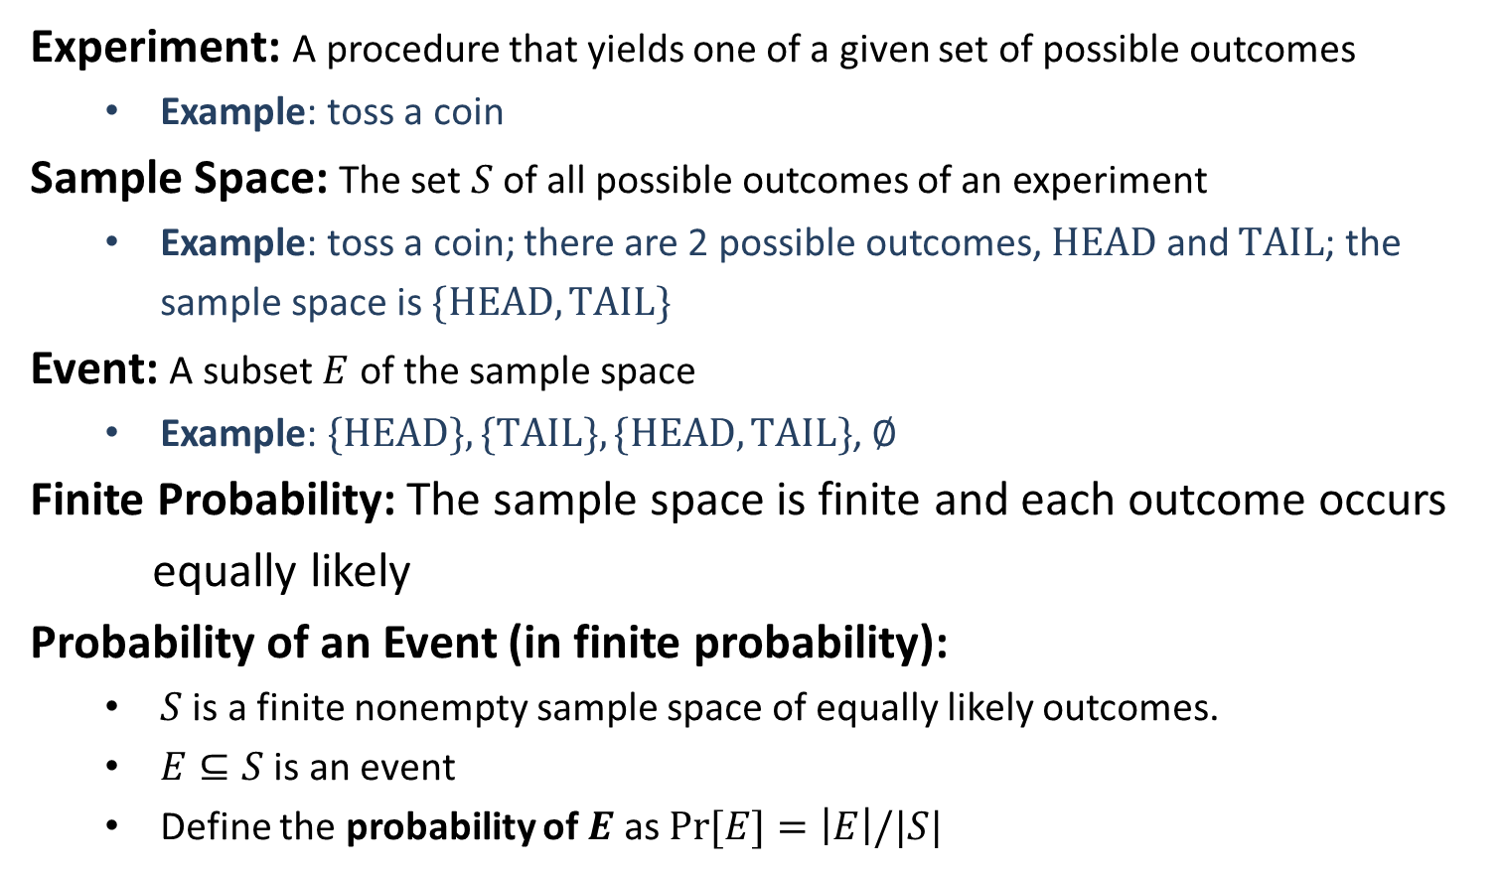
Finite Probability
Experiment: A procedure that yields one of a given set of possible outcomes
Example: toss a coin
Sample Space: The set $S$ of all possible outcomes of an experiment
Example: toss a coin; there are 2 possible outcomes, $HEAD$ and $TAIL$; the sample space is $\{HEAD, TAIL\}$
Event: A subset $E$ of the sample space
Example: $\{HEAD\}, \{TAIL\}, \{HEAD, TAIL\}$, $∅$
Finite Probability: The sample space is finite and each outcome occurs
equally likely
Probability of an Event (in finite probability):
$S$ is a finite nonempty sample space of equally likely outcomes.
$E⊆S$ is an event
Define the probability of $E$ as $\operatorname{Pr}{[E]}=\left|E\right|/|S|$

Slide 15
Example
The probability that a hand of 5 poker cards contains 4 cards of 1 kind?
Experiment: randomly choose 5 cards from 52 indistinguishable poker cards
Sample Space: $S=\left\{hands of 5 poker cards\right\}, \left|S\right|=\left(\begin{aligned}52 \\ 5\end{aligned}\right)$
Finite sample space, each outcome occurs equally likely
Event: $E=\{s∈S:s contains 4 cards of 1 kind\}$
$\left|E\right|=\left(\begin{aligned}13 \\ 1\end{aligned}\right)⋅\left(\begin{aligned}48 \\ 1\end{aligned}\right)$
Probability of the event $E$
$\operatorname{Pr}{[E]}=\frac{\left|E\right|}{|S|}=\frac{13×48}{\left(\begin{aligned}52 \\ 5\end{aligned}\right)}≈0.00024$

